Slide 1

CEIR Immigration Stakeholder -Training Manual

Slide 2

Agenda
Definition and Overview
Assumptions
Features
Registration
Dashboard
Register Device
Grievance
Profile Management

Slide 3
Immigration - Definition
Immigration is the international movement of people to a destination country of which they are not native or where they do not possess citiizenship. This movement can be related to work, leisure activites, sight seeing. Etc
A visa is a conditional authorization granted by a territory to a foreigner, allow them to enter, remain within or to that leave that territory. Visa typically include limits on the duration of the stay with the country they may enter. A visa most commonly take the from of a sticker endorsed in the application’s passport
Visa can be taken apriori before landing to foreign land or on arrival.
Visa can be of different type related to the purpose of the visit. Most common type are tourist visa, work permit visa, business visa, pilgrimage visa , student visa, spouse visa etc
For some country, visa is not required due to bilateral treaty /agreement between two countries
Cambodian Immigration department (Government) is responsible for managing the visa and movement of people in the country.

Slide 4

Immigration Role w.r.t. CEIR
Leaving Cambodia
Immigration
System
Coming to Cambodia
Immigration
System
Local Cambodian
Foreigner
Immigration
System
Immigration
System
Coming back to
Cambodia
Going back from
Cambodia
Local Cambodian
Foreigner

Slide 5
Immigration Role w.r.t. CEIR
User – Both Foreigner / Local Cambodian, can bring devices while entering to Cambodia
Foreigner may or may not have the visa
Foreigner is travelling with a legal document as Passport, while coming to Cambodia
Only interested in the foreigner interaction with Immigration at the time of entry.
If foreigner has register the device using “Register Device” Feature available to end user, this flow will not be required.

Slide 6
Assumptions
Immigration department official may or may share the information with CEIR team
End user will anyway have all the informaiton available with them w.r.t. to
Device Brought to the country
Visa Details
End user will update this infrormation using the End user featues
Register Device
Visa Update
To support end user (only foreigner) in case they are not able to upload the device information, a front end desk would be available at all exit points
Foreigner complete immigration formalties
Foreigner collect luggage
Foreigner clear customs (green channel or red channel)
Foreigner take taxi , buy SIM, etc. At this time, they will also register the devices

Slide 7
Why Register Device is Required
To build whitelist. -
Cambodian user can bring devices from outside
Foreigner can bring device from outside.
This is one source of building the whitelist database
To build Tax Paid DB
Cambodian user can bring devices from outside has to pay taxes
Foreigner can bring device from outside beyond certain limit has to pay taxes
This is one source of building the tax paid database
End user will anyway have all the informaiton available with them w.r.t. to
Device Brought to the country
Visa Details
End user will update this infrormation using the End user featues
Register Device
Visa Update
To support end user (only foreigner) in case they are not able to upload the device information, a front end desk would be available at all exit points
Foreigner complete immigration formalties
Foreigner collect luggage
Foreigner clear customs (green channel or red channel)
Foreigner take taxi , buy SIM, etc. At this time, they will also register the devices

Slide 8
Immigration Agent – System Interface

Slide 9
Assumptions
1 | The Immigration official will also be responsible to register user visa details, the device registration will be done by Cambodia Entry point Device activation Team.
2 | Regulation has to be in place for rejecting the device upload based on the Invalid TAC.

Slide 10
Registration – Immigration
Reporting Manager details to be shared along with employment details

Slide 11
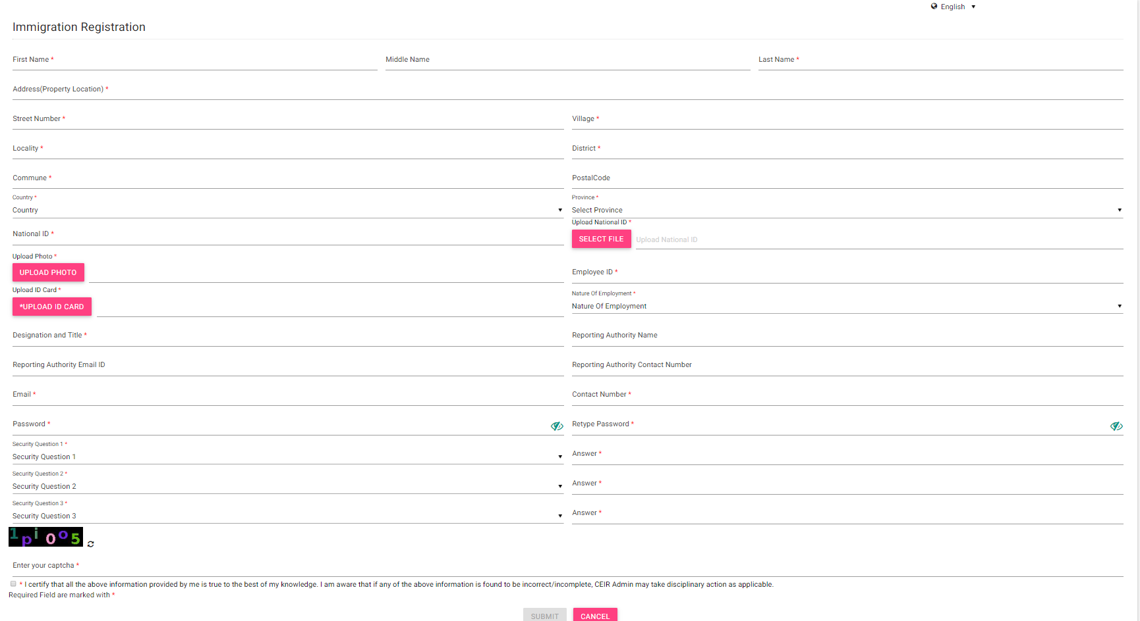
Registration – Immigration (Form)

Slide 12
Dashboard – Immigration
The Dashboard has information about the following
Total number of registered device request
Total Devices in transit
Total Grievances raised
Notifications on feature requests raised by the Immigration

Slide 13
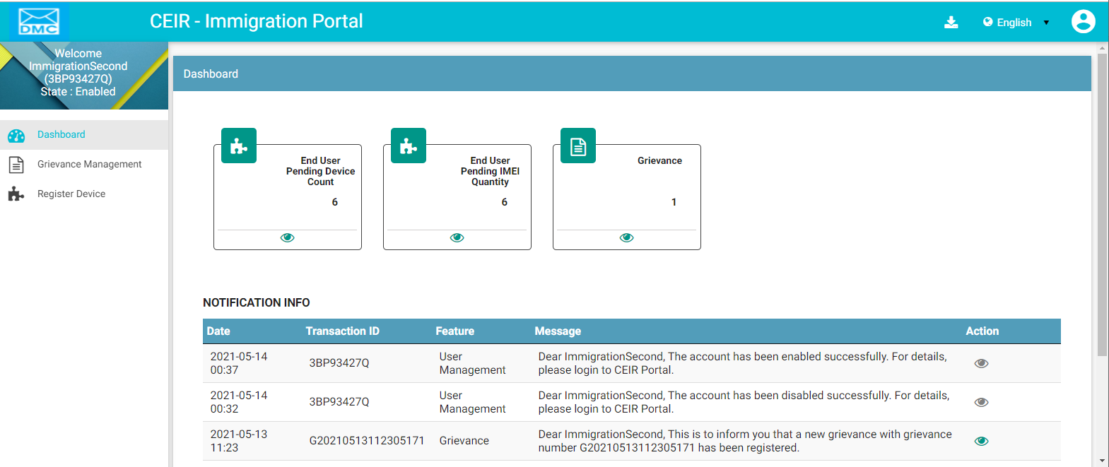
Dashboard – Immigration
Download User Manual
Left Panel
Work Area
Edit Profile
Language Change
On click it takes user to respective home page
Notifications

Slide 14
Register Device

Slide 15
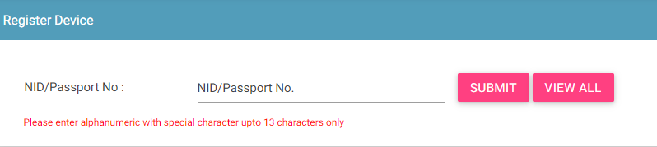
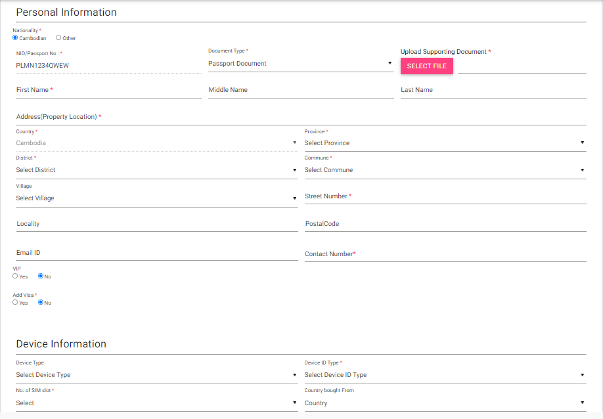
Register Device
Step 1:
Step 2:

Slide 16
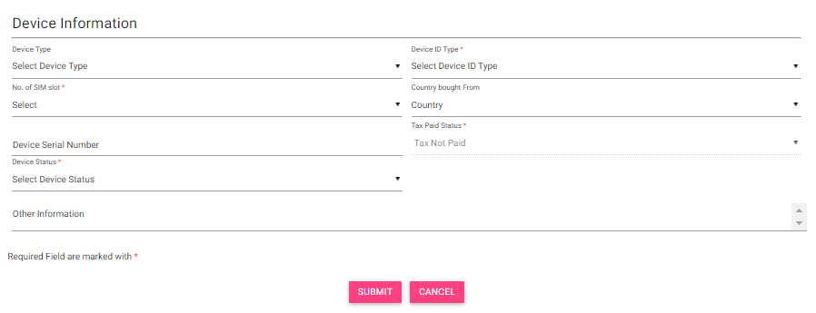
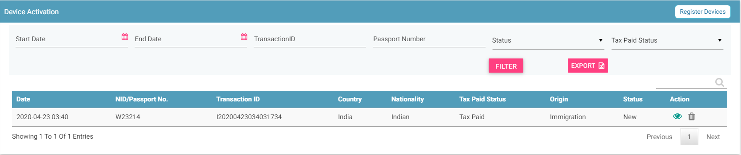
Register Device (Contd..)
Step 3:
Step 4:

Slide 17
Grievance

Slide 18
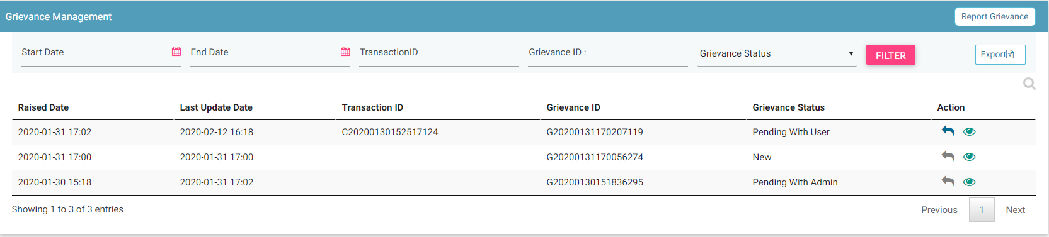
Grievance
Filters
Report
Export
View All grievances
Action like View, Reply

Slide 19
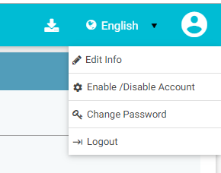
Profile Management

Slide 20
Queries

Slide 21
Thank You

